Slide 1
Office Computer Application WEEK TEN
Muhammad Unggul Pamenang

Slide 2
Please Do It With MS Excel from 2010 - 2016

Slide 3
Modifying Columns, Rows, and Cells
3
MS Excel 2016

Slide 4
Introduction
By default, every row and column of a new workbook is set to the same height and width. Excel allows you to modify column width and row height in different ways, including wrapping text and merging cells.

Slide 5
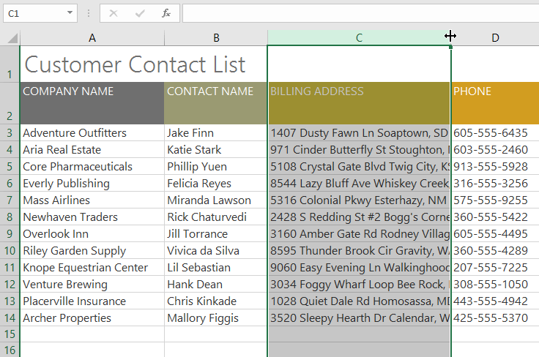
To modify column width:
In our example below, column C is too narrow to display all of the content in these cells. We can make all of this content visible by changing the width of column C.
Position the mouse over the column line in the column heading so the cursor becomes a double arrow.

Slide 6
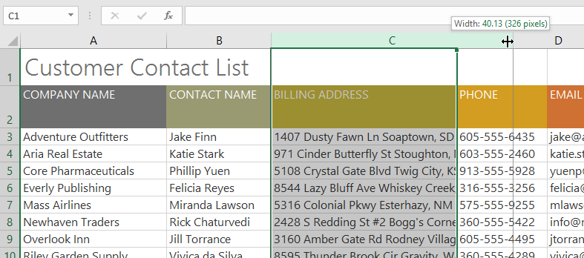
To modify column width:
Click and drag the mouse to increase or decrease the column width.

Slide 7
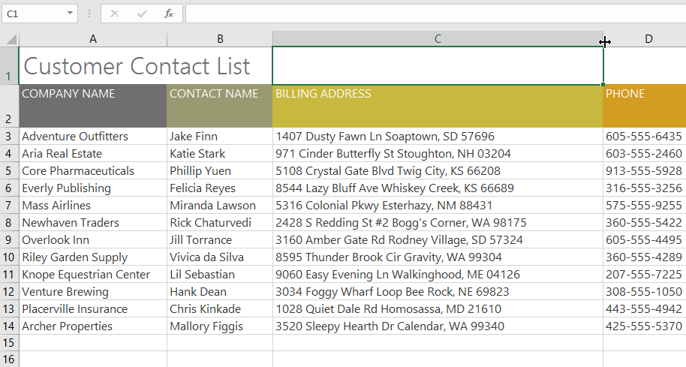
To modify column width:
Release the mouse. The column width will be changed.

Slide 8
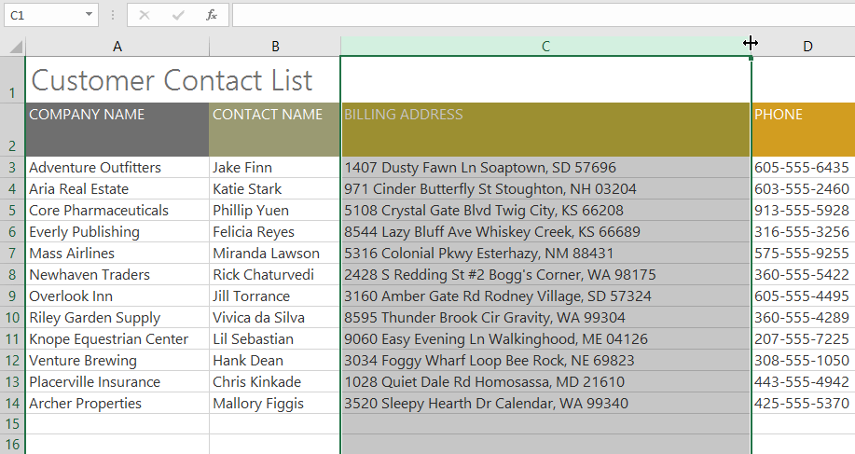
To AutoFit column width:
The AutoFit feature will allow you to set a column's width to fit its content automatically.
Position the mouse over the column line in the column heading so the cursor becomes a double arrow.

Slide 9
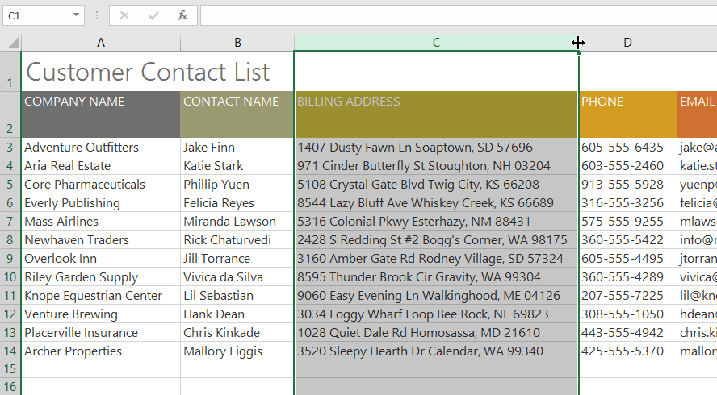
To AutoFit column width:
Double-click the mouse. The column width will be changed automatically to fit the content.

Slide 10
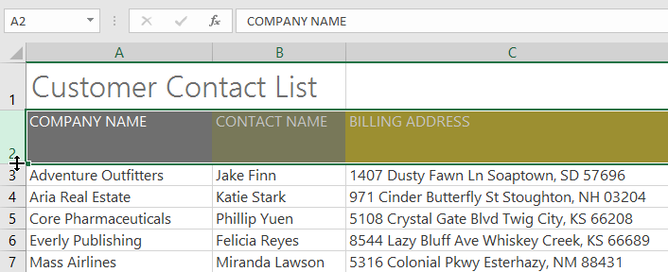
To modify row height:
Position the cursor over the row line so the cursor becomes a double arrow.

Slide 11
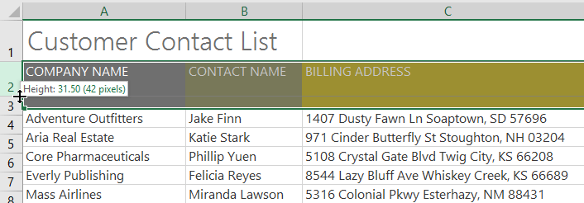
To modify row height:
Click and drag the mouse to increase or decrease the row height.

Slide 12
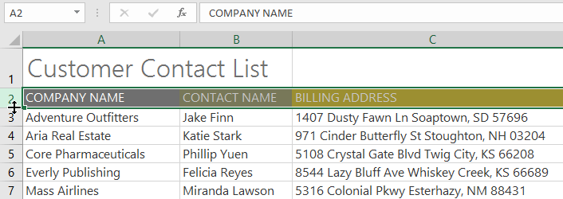
To modify row height:
Release the mouse. The height of the selected row will be changed.

Slide 13
To modify all rows or columns:
Instead of resizing rows and columns individually, you can modify the height and width of every row and column at the same time. This method allows you to set a uniform size for every row and column in your worksheet. In our example, we will set a uniform row height.

Slide 14
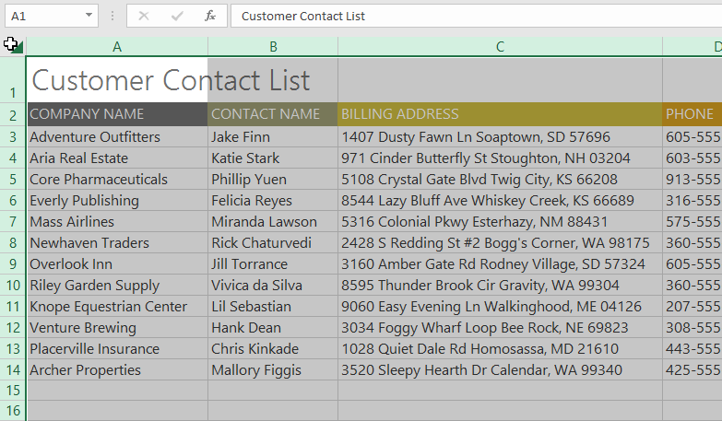
To modify all rows or columns:
Locate and click the Select All button just below the name box to select every cell in the worksheet.

Slide 15
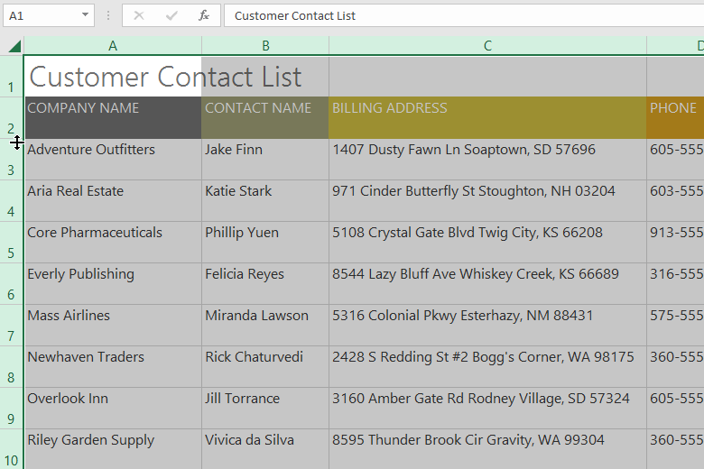
To modify all rows or columns:
Position the mouse over a row line so the cursor becomes a double arrow.
Click and drag the mouse to increase or decrease the row height, then release the mouse when you are satisfied. The row height will be changed for the entire worksheet.

Slide 16
Inserting, deleting, moving, and hiding
After you've been working with a workbook for a while, you may find that you want to insert new columns or rows, delete certain rows or columns, move them to a different location in the worksheet, or even hide them.

Slide 17
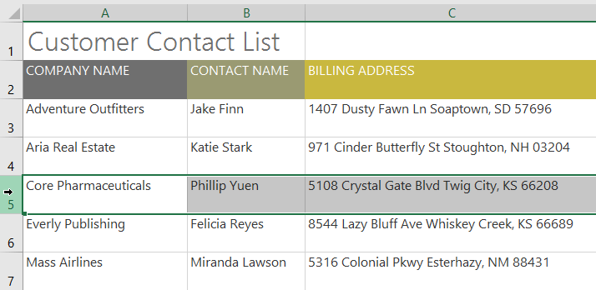
To insert rows:
Select the row heading below where you want the new row to appear. In this example, we want to insert a row between rows 4 and 5, so we'll select row 5.

Slide 18
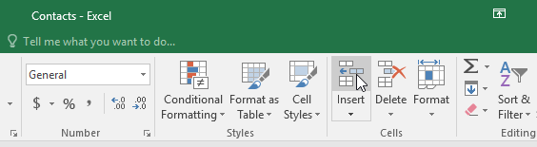
To insert rows:
Click the Insert command on the Home tab.

Slide 19
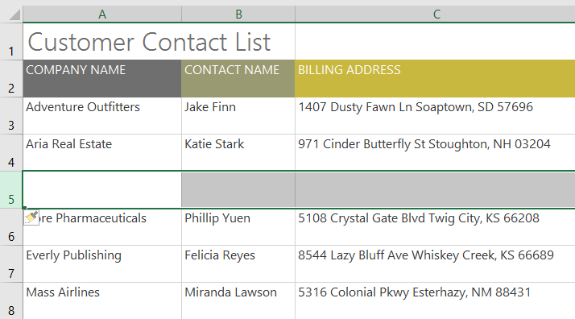
To insert rows:
The new row will appear above the selected row.

Slide 20
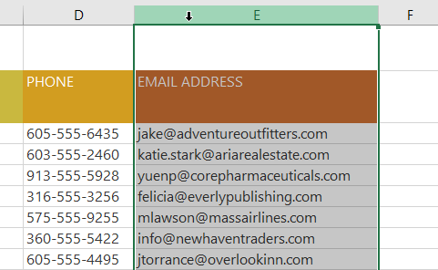
To insert columns:
Select the column heading to the right of where you want the new column to appear. For example, if you want to insert a column between columns D and E, select column E.

Slide 21
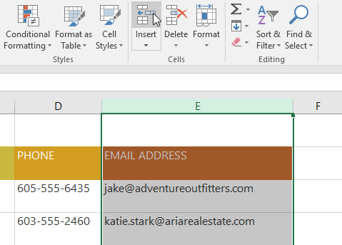
To insert columns:
Click the Insert command on the Home tab.

Slide 22
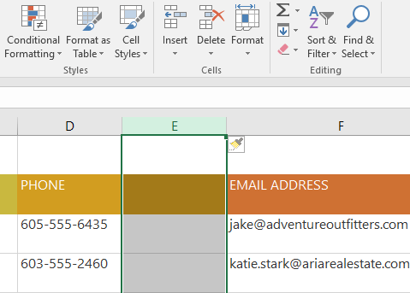
To insert columns:
The new column will appear to the left of the selected column.

Slide 23
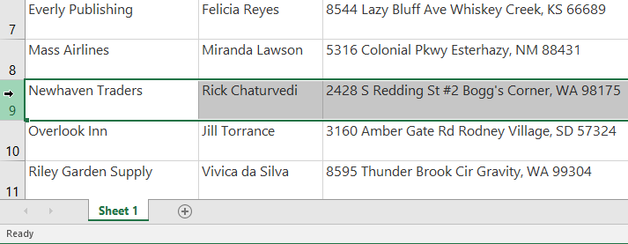
To delete a row or column:
t's easy to delete a row or column that you no longer need. In our example we'll delete a row, but you can delete a column the same way.
Select the row you want to delete. In our example, we'll select row 9.

Slide 24
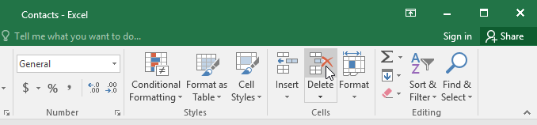
To delete a row or column:
Click the Delete command on the Home tab.

Slide 25
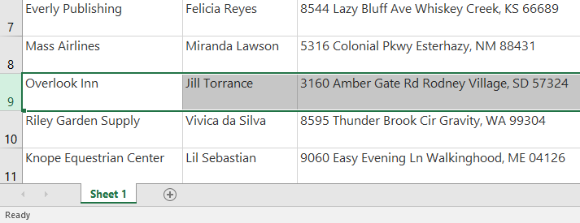
To delete a row or column:
The selected row will be deleted, and those around it will shift. In our example, row 10 has moved up, so it's now row 9.

Slide 26
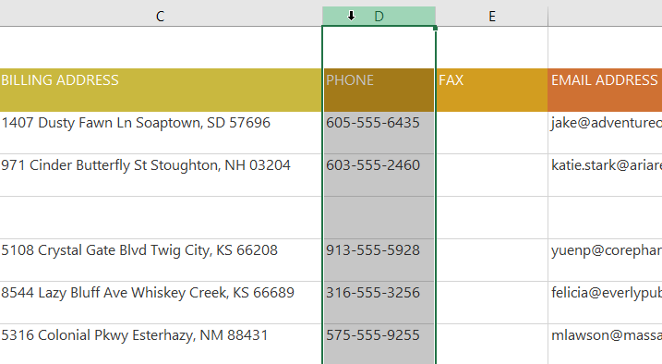
To move a row or column:
Sometimes you may want to move a column or row to rearrange the content of your worksheet. In our example we'll move a column, but you can move a row in the same way.
Select the desired column heading for the column you want to move.

Slide 27
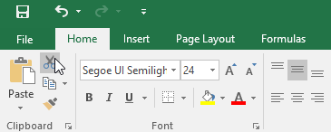
To move a row or column:
Click the Cut command on the Home tab, or press Ctrl+X on your keyboard.

Slide 28
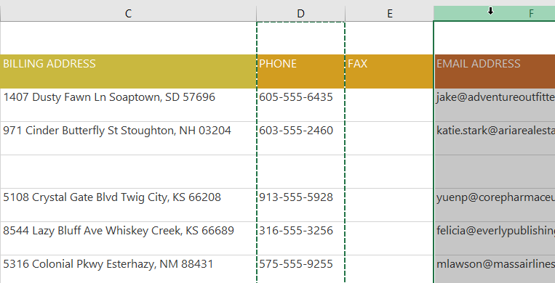
To move a row or column:
Select the column heading to the right of where you want to move the column. For example, if you want to move a column between columns E and F, select column F.

Slide 29
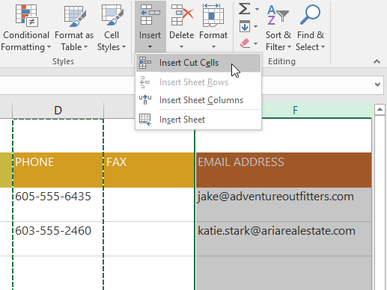
To move a row or column:
Click the Insert command on the Home tab, then select Insert Cut Cells from the drop-down menu.

Slide 30
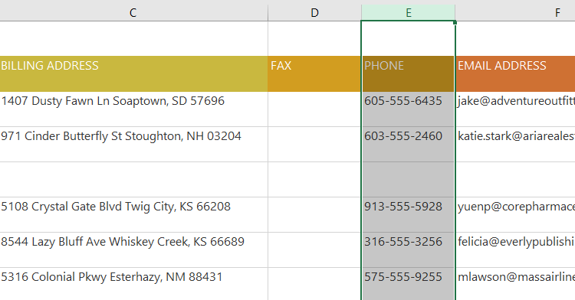
To move a row or column:
The column will be moved to the selected location, and the columns around it will shift.

Slide 31
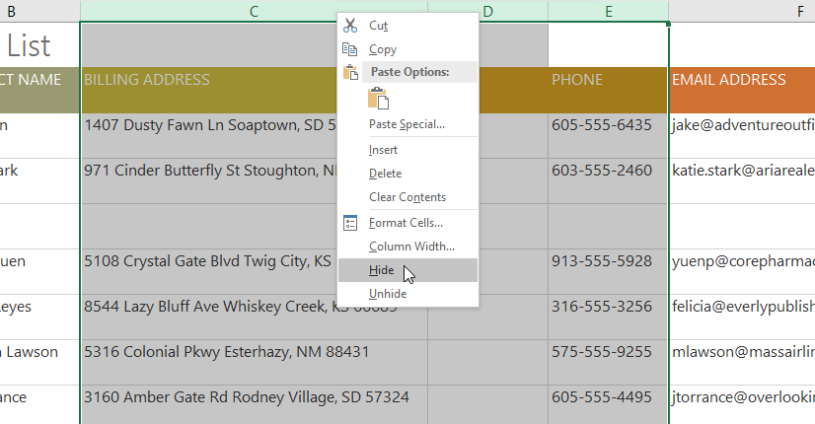
To hide and unhide a row or column:
At times, you may want to compare certain rows or columns without changing the organization of your worksheet. To do this, Excel allows you to hide rows and columns as needed. In our example we'll hide a few columns, but you can hide rows in the same way.
Select the columns you want to hide, right-click the mouse, then select Hide from the formatting menu. In our example, we'll hide columns C, D, and E.

Slide 32
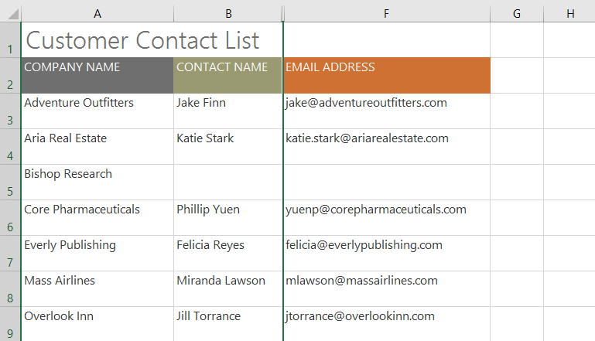
To hide and unhide a row or column:
The columns will be hidden. The green column line indicates the location of the hidden columns.

Slide 33
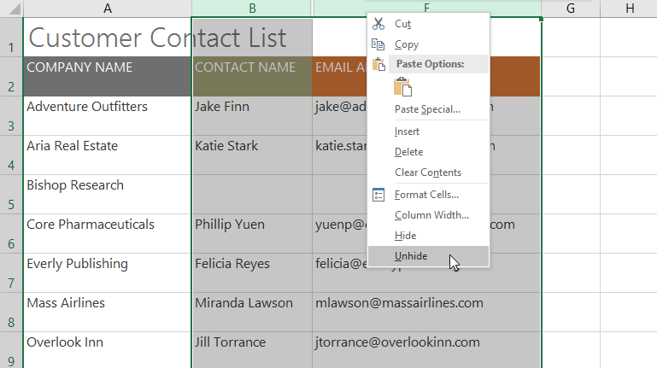
To hide and unhide a row or column:
To unhide the columns, select the columns on both sides of the hidden columns. In our example, we'll select columns B and F. Then right-click the mouse and select Unhide from the formatting menu.

Slide 34
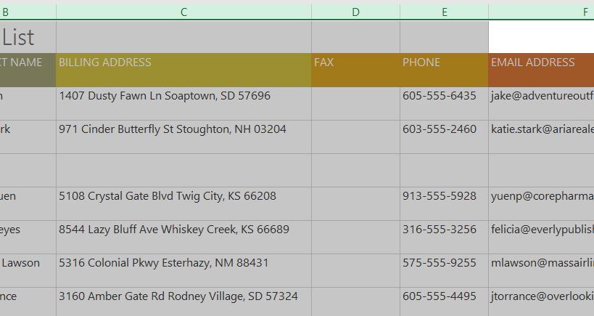
To hide and unhide a row or column:
The hidden columns will reappear.

Slide 35
Wrapping text and merging cells
Whenever you have too much cell content to be displayed in a single cell, you may decide to wrap the text or merge the cell rather than resize a column. Wrapping the text will automatically modify a cell's row height, allowing cell contents to be displayed on multiple lines. Merging allows you to combine a cell with adjacent empty cells to create one large cell.

Slide 36
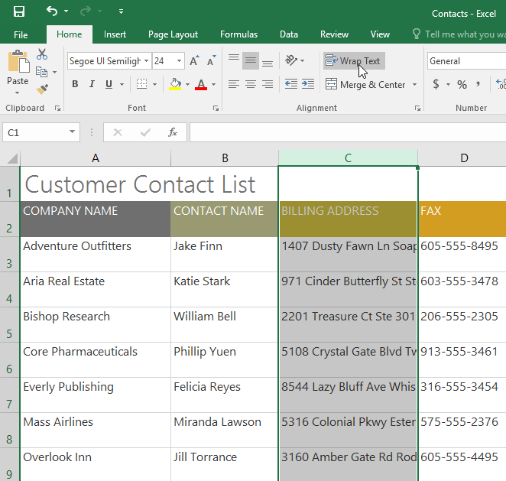
To wrap text in cells:
Select the cells you want to wrap. In this example, we'll select the cells in column C.
Click the Wrap Text command on the Home tab.

Slide 37
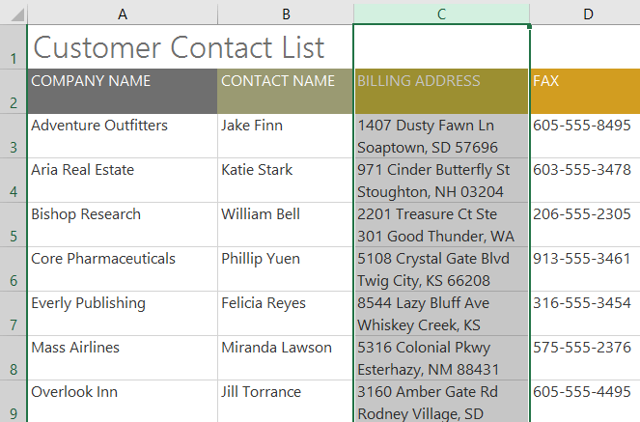
To wrap text in cells:
The text in the selected cells will be wrapped.

Slide 38
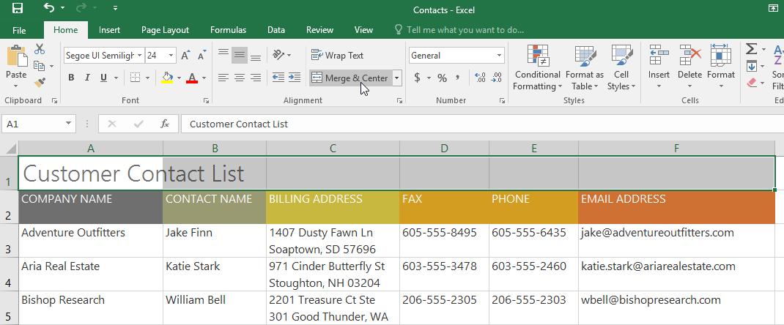
To merge cells using the Merge & Center command:
Select the cell range you want to merge. In our example, we'll select A1:F1.
Click the Merge & Center command on the Home tab. In our example, we'll select the cell range A1:F1.

Slide 39
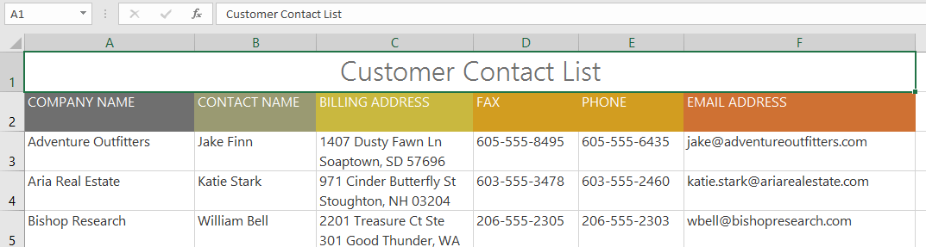
To merge cells using the Merge & Center command:
The selected cells will be merged, and the text will be centered.

Slide 40
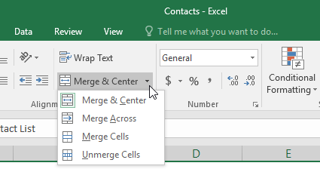
To access more merge options:
If you click the drop-down arrow next to the Merge & Center command on the Home tab, the Merge drop-down menu will appear.

Slide 41
To access more merge options:
From here, you can choose to:
Merge & Center: merges the selected cells into one cell and centers the text
Merge Across: merges the selected cells into larger cells while keeping each row separate
Merge Cells: merges the selected cells into one cell but does not center the text
Unmerge Cells: unmerges selected cells

Slide 42
To center across selection:
Merging can be useful for organizing your data, but it can also create problems later on. For example, it can be difficult to move, copy, and paste content from merged cells. A good alternative to merging is Center Across Selection, which creates a similar effect without actually combining cells

Slide 43
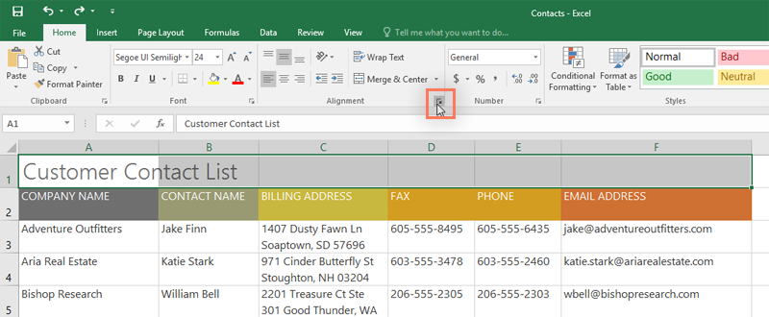
To center across selection:
Select the desired cell range. In our example, we'll select A1:F1. Note: If you already merged these cells, you should unmerge them before continuing to step 2.
Click the small arrow in the lower-right corner of the Alignment group on the Home tab.

Slide 44
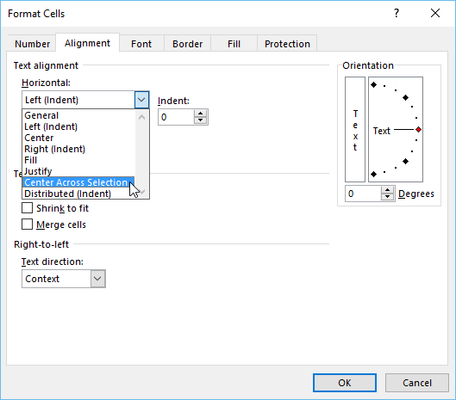
To center across selection:
A dialog box will appear. Locate and select the Horizontal drop-down menu, select Center Across Selection, then click OK.

Slide 45
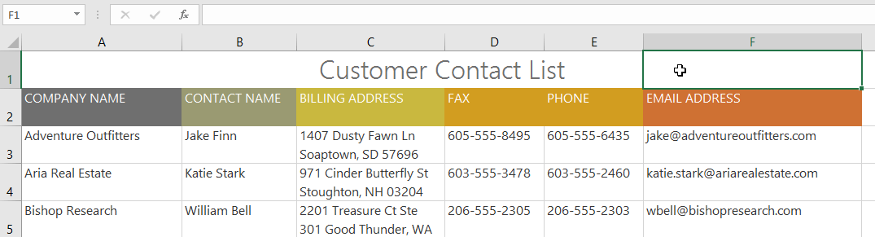
To center across selection:
The content will be centered across the selected cell range. As you can see, this creates the same visual result as merging and centering, but it preserves each cell within A1:F1.

Slide 46
JOBSHEET
Continue working

Slide 47
THANKS!

